Slide 1
Flexible Budget

Slide 2

Poll based on previous lecture
McDonalds use an effective inventory control system based on EOQ.
Annual demand = 6000 units
Ordering Cost = Rs. 60
Carrying Cost = Rs. 2
The EOQ of McDonalds in this particular case will be____
632 units
630 units
650 units
600 units
Notes:
d

Slide 3
Learning Outcomes
Recognize the significance of preparing flexible budgets in the businesses.
Construct the flexible budget by comprehending the fixed, variable and semi – variable costs of the business.

Slide 4

Notes:
1.) 2 wheelers makes up 2.2% of total vehicle sales 2.) Cheapest Tesla car costs Rs. 30 lakhs
3.) Non existent battery charging infra structure

Slide 5
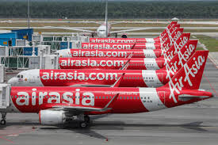
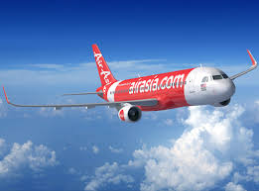
Budgets at Air Asia
‘Air Asia’ prepared estimates of Sales of it’s air tickets from (1st April 2020 – 31st March 2021).
These estimates are based upon the ever changing business conditions.
Worst Scenario (suspension of flights with on struck of new strains of Covid virus; no sales)
Normal Scenario (when sales are normal, flights are operational)
Best Scenario (when sales are high, during festive seasons such as Xmas, New year etc)

Slide 6
What Air Asia is actually doing?
Preparing Flexible Budget
Prepared for different levels of activities
Adjusted according to changing busines conditions
Dynamic in nature
Divides cost into fixed, variable, semi variable costs

Slide 7
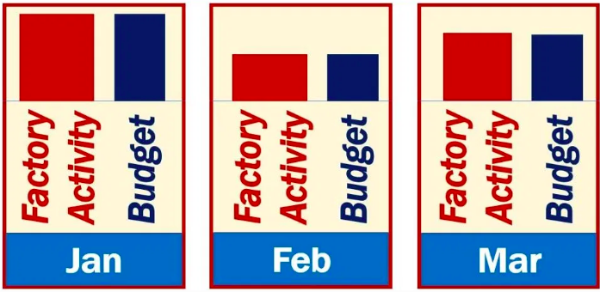
Flexible Budget {Varies according to changing needs of business}

Slide 8
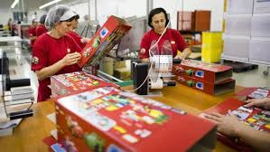
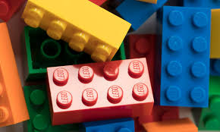
A.) Preparing Flexible Budget of Lego
Following information given for making 1000 toys in a factory of Lego
Prepare ‘Flexible Budget’ for producing:
2000 toys
6000 toys
Particulars | Cost per unit (in Rs.)
Fixed Expenses a) Rent and rates b) Salaries | 10 20
Variable Expenses a) Material b) Labor | 40 20

Slide 9
Particulars | FLEXIBLE BUDGET
Particulars | 1000 units | Per Unit Cost | 2000 units | Per Unit Cost | 6000 units | Per Unit Cost
 | Total Cost | Per Unit Cost | Total Cost | Per Unit Cost | Total Cost | Per Unit Cost

Slide 10
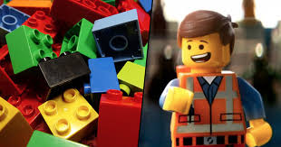
Poll
Lego has prepared a flexible budget to manufacture rubber toys at 40% capacity, 60% capacity and at 100% capacity.
At 100% capacity, the total fixed costs of the company were Rs. 100,000.
In such case, the total fixed costs (in Rs.) at 60% capacity will be:
60,000
160,000
100,000
40,000

Slide 11
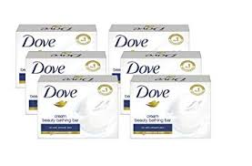
B.) Preparing Flexible Budget of HUL
Following information given for making 4000 units of Dove soaps in a factory of HUL
Prepare ‘Flexible Budget’ for producing:
2000 units
6000 units
Particulars | Cost per unit (in Rs.)
Semi – Variable Expenses a) Electricity charges (10% fixed) b) Salesmen Salaries (30% fixed) | 20 40

Slide 12
Particulars | FLEXIBLE BUDGET
Particulars | 4000 units | Per Unit Cost | 2000 units | Per Unit Cost | 6000 units | Per Unit Cost
 | Total Cost | Per Unit Cost | Total Cost | Per Unit Cost | Total Cost | Per Unit Cost

Slide 13
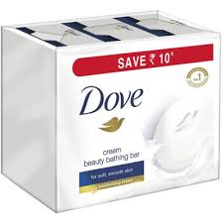
Poll
HUL has prepared a flexible budget to manufacture 1000 units of Dove Soaps.
The per unit cost of it’s semi – variable expenses is Rs. 10 (40% is fixed)
In such case, the total variable costs (in Rs.) will be:
6000
4000
10000
16000

Slide 14
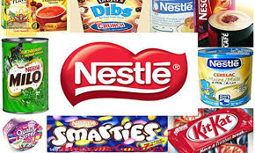
C.) Preparing Flexible Budget of Nestle Inc.
Following information is given at 4000 units
Prepare ‘Flexible Budget’ at 6000 units
Particulars | Amount (in Rs.)
Variable Cost: Direct labor Material Cost | 18,000 6,000
Semi – variable cost: Power (30% fixed) | 40,000
Fixed Overheads: Insurance Depreciation | 10,000 5,000

Slide 15
Particulars | FLEXIBLE BUDGET
Particulars | 40% Capacity | Per Unit Cost | 60% Capacity | Per Unit Cost
 | Total Cost | Per Unit Cost | Total Cost | Per Unit Cost

Slide 16
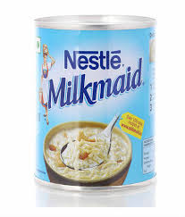
Poll
Nestle India has prepared a flexible budget to manufacture 1000 units of Milkmaids.
The total semi – variable expenses are Rs. 40,000 (70% fixed, 30% variable).
In such case, the per unit fixed costs (in Rs.) will be:
28
40
12
16

